Slide 1
Predicting Stock Prices using Daily News Headlines
Spandan Gupta
Spring 2020

Slide 2
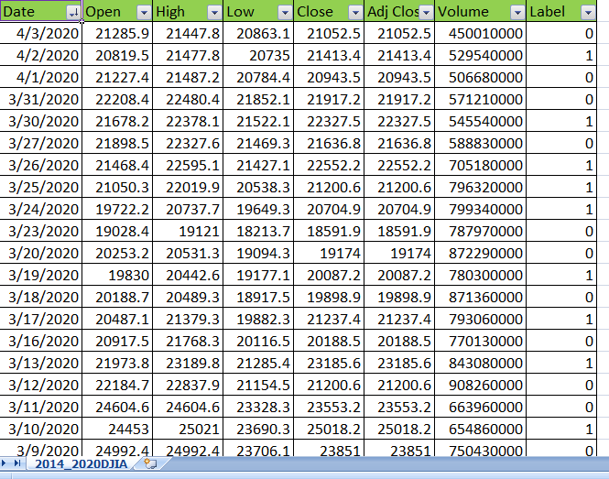
DJIA Historical Stock Data

Slide 3
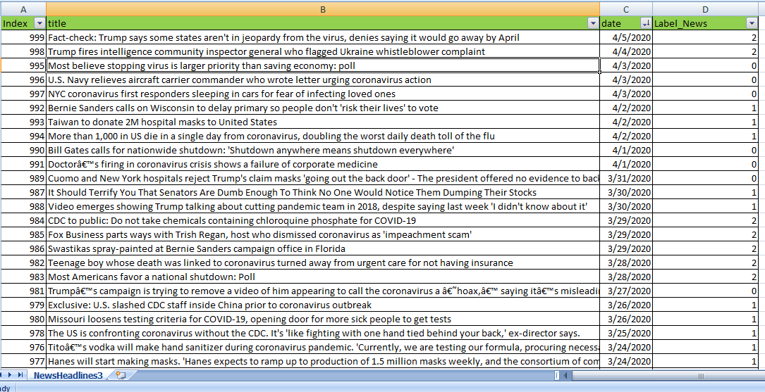
Top News Headlines on Reddit

Slide 4
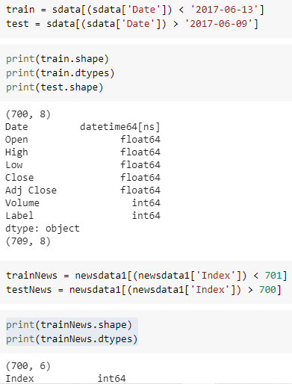
Train and test split
The ratio to divide the train and split is chosen to be 70-30.

Slide 5
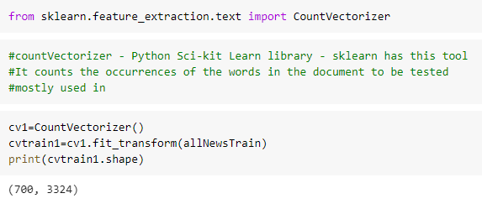
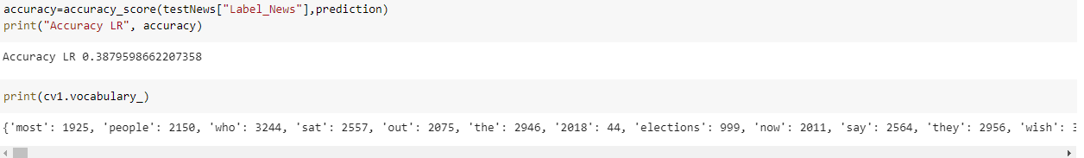
Count Vectorizer
Count Vectorizer, counts the number of times the keyword appears.
Creates a matrix of token counts

Slide 6
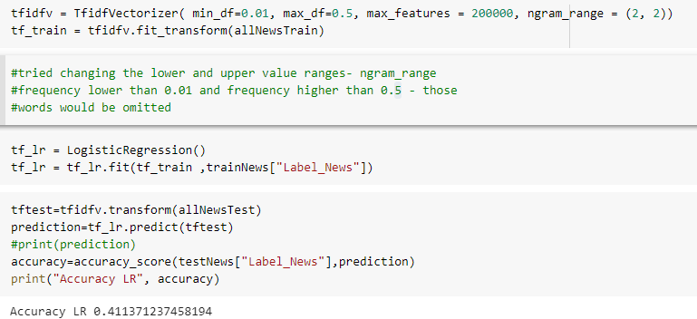
Logistic Regression
Accuracy score = 0.408

Slide 7
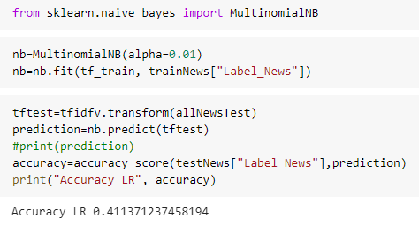
Naive Bayes
A probabilistic Classifier based on Bayes Theorem
Considers the probability of an outcome regardless of correlations[3]

Slide 8
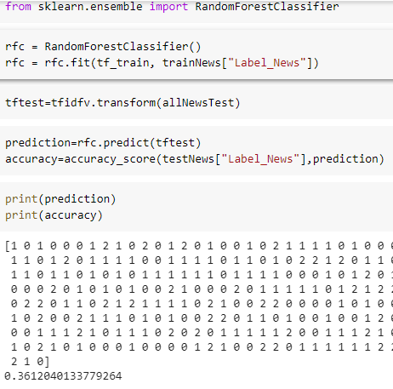
Random Forest Classifier
Random sampling of training data points when building trees

Slide 9
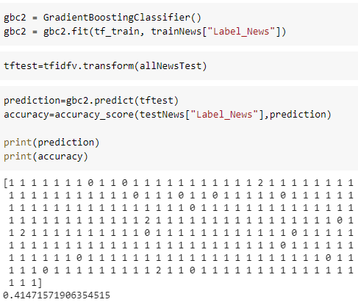
Gradient Boosting Classifier
A group of ML models that combine many weak learning models to create a strong predictive model.

Slide 10
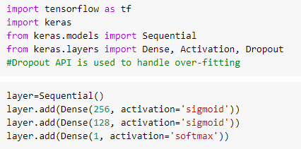
Multi-layer feed forward Deep Neural Network
Feed-forward neural networks are inspired by the information processing of one or more neural cells, called a neuron [1]

Slide 11
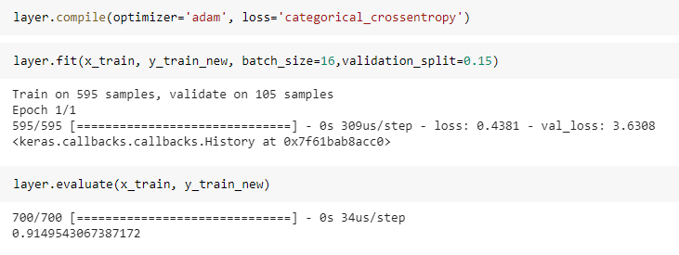
Evaluation of Multi Layer Network

Slide 12
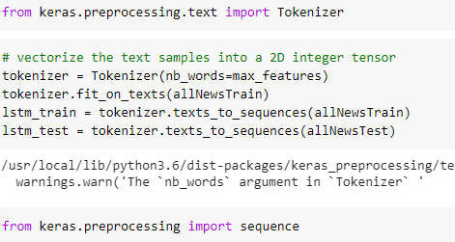
LSTM
Long Short-Term Memory (LSTM) networks are a type of recurrent neural network capable of learning order dependence in sequence prediction problems. [1]

Slide 13
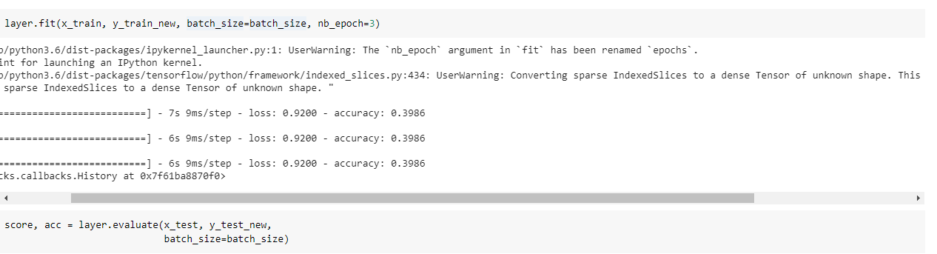
Accuracy of LSTM

Slide 14
Conclusion and Future Work
As understood from the accuracy score achieved, it states the fact that stock prices are the most difficult to predict. Also probably,
The Future Work would be figure out other factors. Link it with a company’s background. Since now I have got a grasp of this, within a week or two I have plan on implementing the prediction of stock prices, based on backgrounds of company. Next step will be to answer questions like, what was related news of Apple company since it’s stock prices dropped. Similarly for Amazon and Facebook, if they are doing good these days, what are the relevant news headlines about them now?

Slide 15
References
[1] Multi layer network, https://www.tutorialspoint.com/keras/keras_deep_learning.htm
[2] LSTM, https://towardsdatascience.com/illustrated-guide-to-lstms-and-gru-s-a-step-by-step-explanation-44e9eb85bf21
[3] Naïve Bayes https://en.wikipedia.org/wiki/Naive_Bayes_classifier

